Slide 1
AZ-400.00 Learning Path 04: Implement a secure continuous deployment using Azure Pipelines

Slide 2
Agenda
Module 01: Introduction to deployment patterns.
Module 02: Implement blue-green deployment and feature toggles.
Module 03: Implement canary releases and dark launching.
Module 04: Implement A/B testing and progressive exposure deployment.
Module 05: Manage application configuration data.
Labs & Learning Path review and takeaways.

Slide 3
Module 01: Introduction to deployment patterns

Slide 4
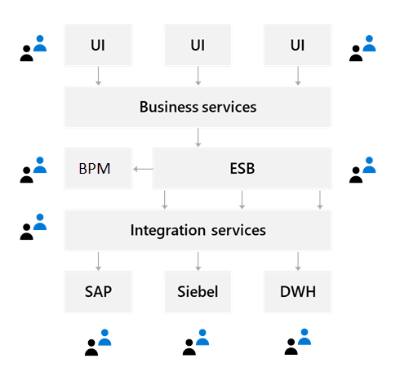
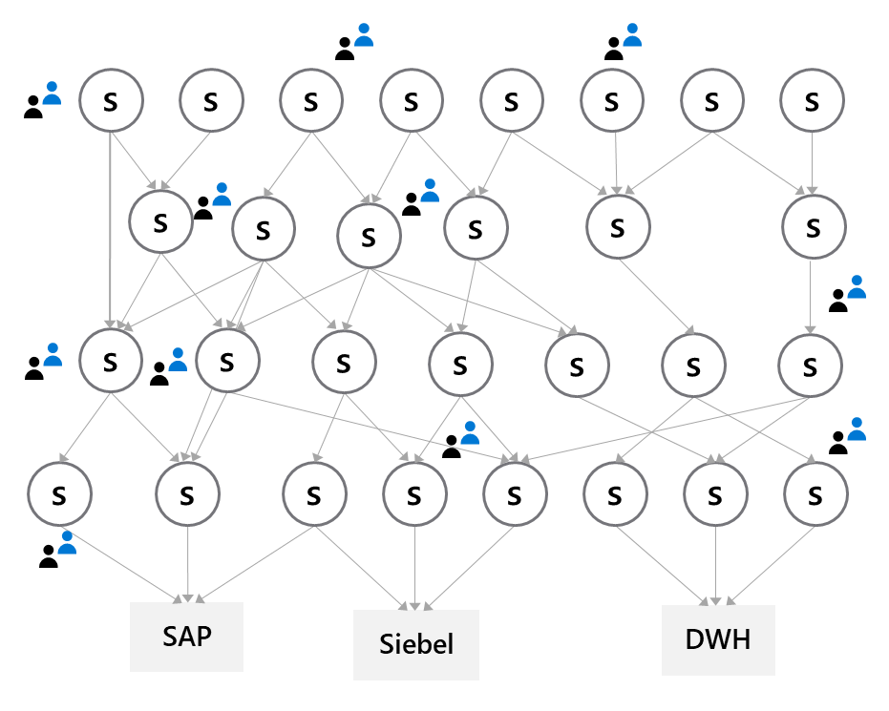
Explore microservices architecture

Slide 5
Examine classical deployment patterns
Dev
Test
Staging
Production

Slide 6
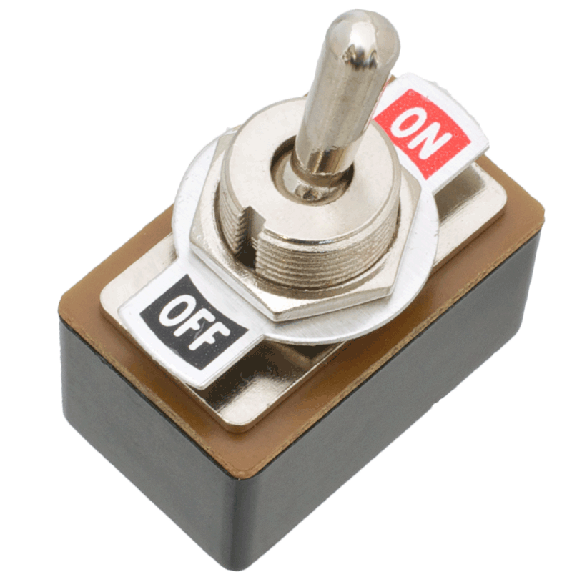
Understand modern deployment patterns
Blue-green deployments
Canary releases
Dark launching
A/B testing
Progressive exposure deployment/ring-based deployments
Feature toggles

Slide 7
Module 02: Implement blue-green deployment and feature toggles

Slide 8
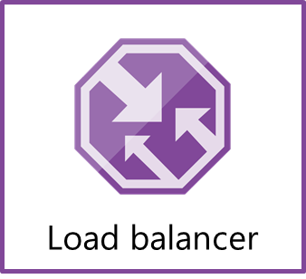
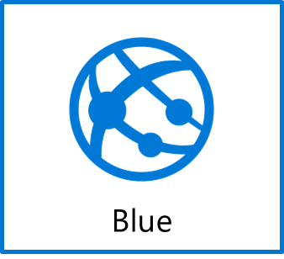

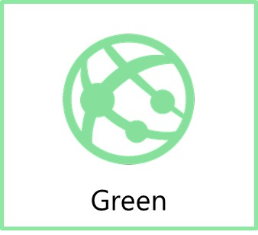
What is blue-green deployment?
www.production.com
Swap
www.temp.production.com

Slide 9
Explore deployment slots
What is it?
A way to set up multiple environments and swap between environments
Why do you need it?
When you want to deploy with zero downtime
When you need to test in production
When you want easy rollback
Swap
The swap process eliminates downtime when you deploy your app with seamless traffic redirection, and no requests are dropped because of swap operations.
Notes:
Explain Swap https://docs.microsoft.com/azure/app-service/deploy-staging-slots#what-happens-during-a-swap.

Slide 10
Introduction to feature toggles
What is it?
Mechanism to separate feature deployment from feature exposure
A.k.a. feature flippers, feature flags, feature switch, conditional feature, etc.
Why do you need it?
It enables you to give control back to the business on when to release the feature
Enables A/B testing, canary releases and dark launching
It provides an alternative to keeping multiple branches in version control
Enables change without redeployment

Slide 11
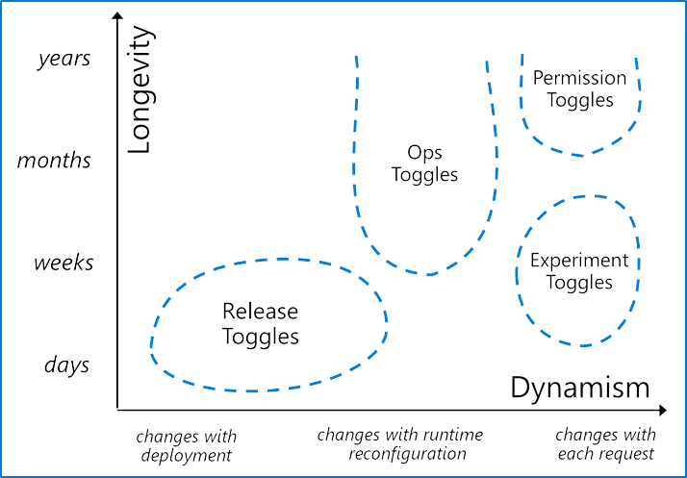
Describe feature toggle maintenance
Feature toggles need to be maintained
Remove them when you can
It is technical debt if you keep them around
Source: http://martinfowler.com/articles/feature-toggles.html

Slide 12
Module 03: Implement canary releases and dark launching

Slide 13

Explore canary releases
What is it?
Releasing a feature to a limited subset of end users
When you want to gradually roll out a feature to ensure success
How to implement it
Use a combination of feature toggles, traffic routing and deployment slots
Route traffic % to a deployment slot with the new feature enabled
Target specific user segment (via feature toggles)

Slide 14
Examine traffic manager
What is it?
Traffic manager provides the ability to control how requests from web clients are distributed to apps in Azure App Service. Within an app service, it routes traffic between deployment slots
Why do you need it?
It enables failover and load distribution capabilities
It enables you to deploy to a slot and then slowly move traffic over to the other slot
What does it offer?
It provides several options for how to distribute traffic, all based on availability

Slide 15
Understand dark launching
Like canary releases, but the aim is to assess response of users to new features
Testing of the back end is not the primary aim
Users are often not aware they are being used to test the new feature

Slide 16
Module 04: Implement A/B testing and progressive exposure deployment

Slide 17
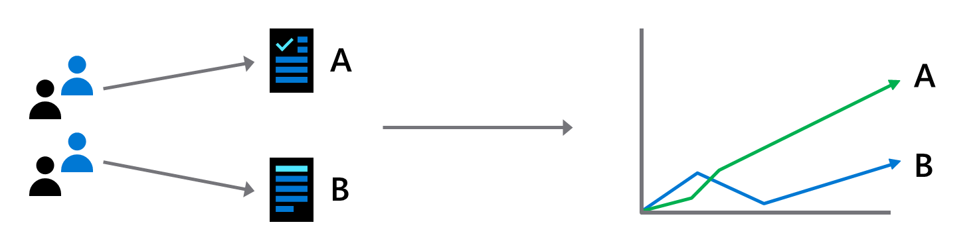
What is A/B testing?
A/B testing is an experiment where two or more variants are shown to users at random, and statistical analysis is used to determine which variation performs better for a given conversion goal

Slide 18
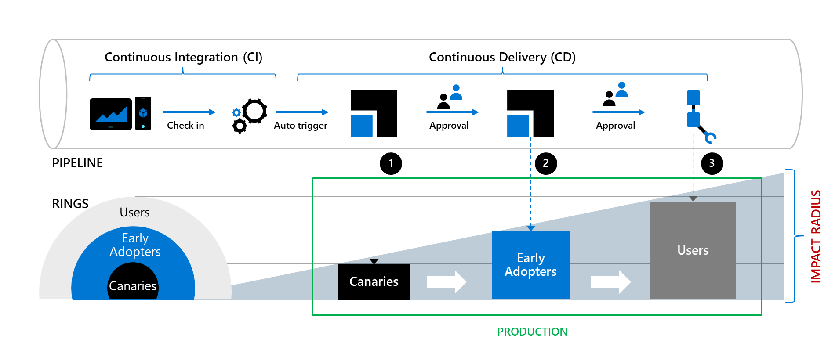
Explore CI/CD with ring-based deployment

Slide 19
Module 05: Manage application configuration data

Slide 20
Rethink application configuration data
Configuration information is stored in files
Changes can require downtime and administrative overhead
Challenging to manage changes to local configurations across multiple running instances of the application
Discussion: How will you secure this information?

Slide 21
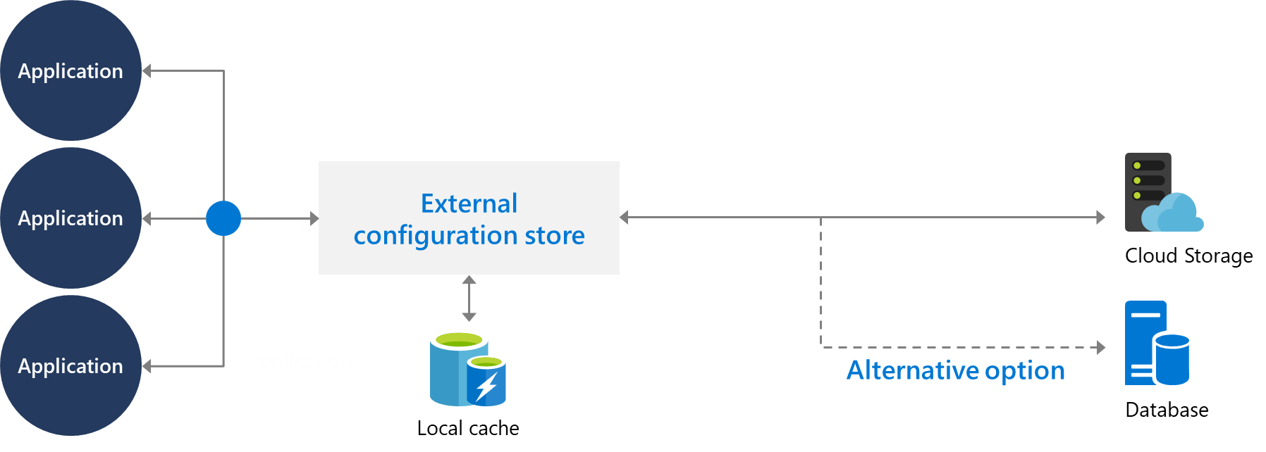
Understand external configuration store patterns
Store the configuration information in external storage.
Provide an interface to quickly and efficiently read and update.

Slide 22

Introduction to Azure App Configuration
Useful for most applications but particularly applicable to:
Distributed applications (particularly microservice applications) Serverless applications
Centralize management and distribution of hierarchical configuration data for different environments and geographies
Dynamically change application settings without the need to redeploy or restart an application
Control feature availability in real-time

Slide 23
Examine Key-value pairs
AppName: Service1:ApiEndpoint
AppName: Service2:ApiEndpoint
AppName: Region1:DbEndpoint
AppName: Region2:DbEndpoint
Key = AppName:DbEndPoint & Label = Test
Key = AppName:DbEndPoint & Label = Staging
Key = AppName:DbEndPoint & Label = Production
Service stores key-value pairs
Keys and values are all Unicode strings
Recommend using hierarchical naming for keys
Labels can be used to store different values for a particular key
Labels can provide a way of versioning keys

Slide 24
Integrate Azure Key Vault with Azure Pipelines
1
Azure Key Vault allows you to manage your organization’s secrets and certificates in a centralized repository.
2
Azure Key Vault stores secrets, keys, and certificates.

Slide 25
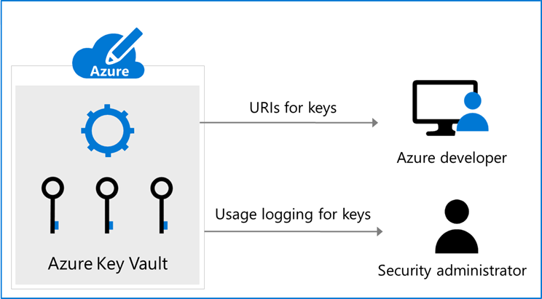
Manage secrets, tokens and certificates
Centralize application secrets
Securely store secrets and keys
Monitor access and use
Simplified administration of application secret
Integrate with other Azure services

Slide 26
Labs

Slide 27
Lab: Integrating Azure Key Vault with Azure DevOps
Objectives:
Lab overview:
In this lab, you will see how you can integrate Azure Key Vault with an Azure DevOps pipeline.
Create a Microsoft Entra service principal
Create an Azure key vault
Track pull requests through the Azure DevOps pipeline
Duration:
Notes:
The labs are updated on a regular basis. For the latest information please visit:
https://microsoftlearning.github.io/AZ400-DesigningandImplementingMicrosoftDevOpsSolutions/

Slide 28
Lab: Enable Dynamic Configuration and Feature Flags
Objectives:
Lab overview:
Azure App Configuration provides a service to centrally manage application settings and feature flags. Use App Configuration to store all the settings for your application and secure their accesses in one place.
Enable dynamic configuration
Manage feature flags
Duration:
Notes:
The labs are updated on a regular basis. For the latest information please visit:
https://microsoftlearning.github.io/AZ400-DesigningandImplementingMicrosoftDevOpsSolutions/

Slide 29
Closing slide

